Slide 1
Strategies for Building Capacity in Economic Development Finance
October 7, 2020

Slide 2
California Association for Local Economic Development
Founded in 1980
Over 700 Members – 75% cities & counties
Dedicated to supporting economic developers working in California Communities
  Training & Education
  Legislative Advocacy
  Economic Development Finance
California Association for Local Economic Development

Slide 3
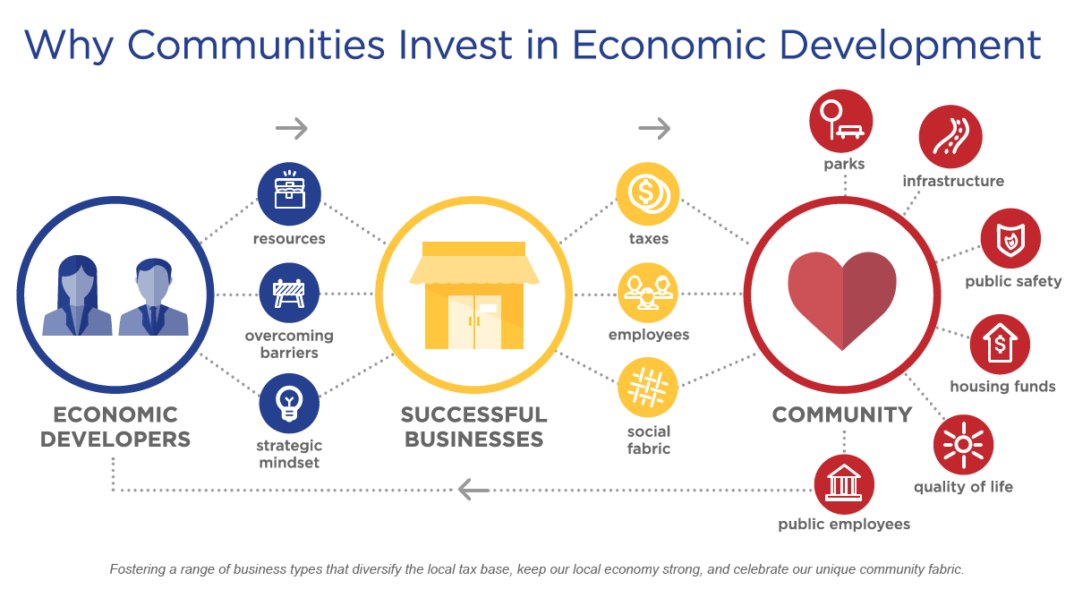
What is Economic Development?
Economic Development is the creation of wealth from which community benefits are realized. It is more than a jobs program, it’s an investment in growing your economy and enhancing the prosperity and quality of life for all residents.
California Association for Local Economic Development

Slide 4
CALED’s Rural Economic Development Exchange
Started in May 2018, the Rural Economic Development Exchange works to…
Convene rural economic development stakeholders throughout the year.
Work with Federal & State Partners in California to identify ways CALED can support their priorities and promote their work/grants.
Share what we learn with partners that may be able to assist in addressing priorities, challenges, solutions, and resources to grow rural economies.
California Association for Local Economic Development

Slide 5
CALED’s Rural Infrastructure Finance Guidebook
Identified that financing infrastructure was a challenge in rural communities
Partnership with California USDA Rural Development
CALED received a one-year grant from USDA Rural Development
Identified Consultants & Contributors
  Council of Development Finance Agencies
  Steve Wahlstrom & Associates
  Sonoma County & City of Santa Rosa
  National Development Council
  Pilot Counties
    Colusa
    Del Norte
    Mono
California Association for Local Economic Development

Slide 6
CALED’s Rural Infrastructure Finance Guidebook
Council of Development Finance Agencies
Models for Financing Staff & Capacity
Create a compendium of finance resources for five infrastructure topics
  Water & Wastewater
  Commercial Speed Broadband
  Transportation
  Housing for All Income Levels
  Commercial & Industrial Site Development
Identifying Priority Projects
California Association for Local Economic Development

Slide 7
CALED’s Rural Infrastructure Finance Guidebook
Steve Wahlstrom & Associates and Pilot Counties
Site Visits
Evaluation of Projects
Financing Plan for one project per county
California Association for Local Economic Development

Slide 8
CALED’s Rural Infrastructure Finance Guidebook
Other Contributors
Disaster Relief Funding-Sonoma County & City of Santa Rosa
Does Your Project Pencil-National Development Council
CALED’s Economic Development Finance & Real Estate Committee
California Association for Local Economic Development

Slide 9
CALED’s Rural Infrastructure Finance Guidebook
Guidebook Distribution
Over 1,100 mailed out
  All CALED Members
  Non-CALED Member Rural Communities
100 to USDA Rural Development
CALED Rural Exchange meeting
Available online to view or download: https://caled.org/california-rural-infrastructure-finance-guidebook/
California Association for Local Economic Development

Slide 10
California Association for Local Economic Development
Michelle Stephens, Program Director
California Association for Local Economic Development
(916) 448-8252 ext. 12
michelle@caled.org
@CALED_EconDev
California Association for Local Economic Development

