Slide 1
How to Address California’s Housing Challenges Together
HCD Presentation
Sohab Mehmood
Senior Policy Manager, Housing Policy Division
Notes:
[Alex]

Slide 2
Codes and Standards
HCD
Division of Financial Assistance
Housing Policy Division
Fair housing
Data and Innovation
Land Use and Local Gov. Relations
Policy and Program
Housing Elements – REAP 2.0 – LEAP – SB2 – Prohousing – ADUs – Preservation – HAU – Technical Assistance
Notes:
Quick overview of our Division and Unit within HCD
•We are with the CA State Department of Housing and Community Development known as HCD. We have three main divisions - one that handles much of our affordable housing financing known as DFA, our codes and standards division and us, the housing policy division of HCD. We largely serve as the planning function of housing policy and HCD.
•Within our division, we have 4 different branches that cover a wide range of projects and policies including our
1) fair housing unit
2) data and innovation unit,
3) land use and local government and relations unit (which many of us are from) and
4) policy and program support unit, and lastly our data and innovation unit.
As mentioned, we are from the Land Use and Local Government Relations branch which handles Housing Element reviews, Incentive programs, Planning grants, ADU ordinances, Preservation, and Accountability for housing law compliance.
More specifically, we are representing the planning grants and incentives unit today. We administer a range of incentive programs geared towards local governments such as Prohousing, planning grants such as REAP, as well as housing elements.

Slide 3
Summary of Strategies and Approaches
Funding:
State and federal financing and affordable housing funding programs
Incentives:
Prohousing Designation Program
Housing Element Complaince
Technical Assistance:
Regional and Statewide
Policy specific issues
Housing Accountability and Enforcement
Notes:
As you might be aware, Since 2017 the legislature has passed a myriad of bills and policies to help support housing production and address the housing crisis.
Part of the approach has been to strengthen existing state laws but to also provide funding directly to local governments to help them respond to new state mandates including the 6th cycle RHNA and to be able to implement Prohousing policies.
In addition, the approach includes providing incentives or sometimes rewards to local governments for doing the right thing. Not only complying with state housing laws but in some cases going beyond state laws to help accelerate housing production on the ground.
But the legislature has also given HCD resources to pair this work with technical assistance to local governments. It’s very much acknowledged that while the funding and incentives are helpful, some of these laws can be complex and there is a need for technical support and subject matter expertises as well as issues with capacity at the local level.
Lastly, with all the fun stuff and carrots, its still important that everyone is held accountable to meeting state laws and doing their part in addressing the housing crisis.
In summary, in the last five years the legislature and HCD has implemented a package of programs and laws that include new requirements to enhance housing laws that promote more housing, support local governments in implementing those laws as well as others that accelerate housing production, and holds jurisdictions accountable for when those laws are not being implemented.

Slide 4
2017
Legislative Housing Package
2018–2020
SB2 Planning Grants NOFA: 491 jurisdictions applied!
LEAP Planning Grant Program: 520 jurisdictions applied
REAP Planning Grants: For Regional Planning
2021
Prohousing Designation Program
SCAG Housing Elements Due
Jan. 2023
REAP 2.0 Program
June 2023
Prohousing Incentive Funding Program
6TH Cycle RHNA
Notes:
2017:
To help provide some context on where we are now and where we have been, since 2017 the legislature has passed a myriad of bills and policies to help support housing production and address the housing crisis.
In 2017, we have what was considered at the time a monumental housing package and one of our first real steps to address the housing crisis.
This package included planning support and homelessness funding, new housing element laws, and enforcement of housing element compliance paired with more capacity and support for HCD to provide technical assistance to jurisdictions. This legislative package also created the first permanent source of funding for affordable housing.
The first year of SB2 funds went to directly to cities and counties to provide them with the funding they need to update planning documents and ordinances, complete rezonings, updating their housing elements, develop ADU incentives, and address other needs to facilitate compliance with the 6th cycle RHNA.
Future years of this funding, so today onwards goes to most local governments under the permanent local housing allocation program also known as PLHA.
After SB2, we also administered additional funding programs through the early action planning grants, again for local governments to assist them in preparing for the 6th cycle, accelerate housing production, providing with funding to continue to do land use, zoning, permit process changes, implement Prohousing policies, address state law changes, etc., This is essentially providing a second round of funding, again to accelerlate housing production and facilitate compliance with the 6th cycle RHNA.
2017-2023
In these years, from 2017-2023, we have also developed and administered similar programs but at regional level which in some cases are then suballocated back to the local level known as the REAP program.
And as mentioned earlier and what will likely be a common theme of our conversation today, that with funding and these incentives, it’s also important to balance and ensure accountability. During this same time, we have seen an increased budget and expansion of our enforcement authorities and the number of state housing laws we are able to enforce. We have also seen a stronger or additional consequences when jurisdictions do not comply with the law ranging from fines, to not being able to access housing funds and potential lawsuits.

Slide 5
Funding
SB2 and LEAP
REAP1.0
REAP 2.0
Accelerating Housing Production
6th Cycle RHNA

Slide 6
Funding
Early Action Planning Grants: To help cities prepare for the 6th cycle and accelerate housing production –
SB2 Planning Grants
LEAP Planning Grants
REAP 1.0
REAP 2.0 – To promote infill production, AFFH and VMT reduction
Prohousing Incentive Program
Development Funds and Financing
Various state and federal programs
PLHA – Permanent local housing allocation. Eligible uses e.g., predevelopment costs, acquisitions, etc.,

Slide 7
Incentives: Prohousing Designation Program
Allow
Allowing residential and mixed-uses by-right
Zone
Zoning more sites for residential or increasing densities
Reduce
Allowing for parking reductions
Limit
Limiting number of public hearings to 3 or less
Adopt
Adopting ADU ordinances that reduce barriers to develop ADUs
Create
Creating objective design and development standards
Establish
Establishing a local housing trust fund
Notes:
Incentives: Prohousing Program:​
​
Our department has also been overseeing programs that incentivize and reward jurisdictions for doing the right things e.g., gaining a compliant housing element, adopting and implementing Prohousing policies such as by-right processes, reduced fees, additional zoning capacity beyond the RHNA, reduction in public hearings and more certainty in approving affordable housing projects, etc.,
One way we have done that through the design and implementation of the Prohousing Designation Program
As mentioned in the last slide, an example of rewarding good actors, the state is currently accepting applications for the Prohousing program. ​
​
The Prohousing Program was a result of the 2019-20 Budget Act and is a way to reward good local actors for enacting land-use and regulatory local policies that are housing-friendly. ​
​
If you are a local govt. and you receive a Prohousing designation, you receive bonus points on several different competitive funding programs. One example is becoming more competitive for different funding programs such as AHSC also known as the Affordable Housing and Sustainable Communities Program, TCC which is also known as the Transformative Climate Communities program, and IIG which is also known as the Infill Infrastructure Grant Program. ​
​
Prohousing policies fall into a few key categories. These categories include favorable zoning, decreased timeframes to approve permits, reducing construction and development costs, and providing financial subsidies. ​
​
HCD accepts applications on an ongoing basis for localities who want to apply to gain a prohousing designation or label. The program will designate jurisdictions as Prohousing, when they demonstrate policies and strategies to accelerate housing production.

Slide 8
Prohousing Designated Jurisdictions
Los Angeles City
El Cerrito
Citrus Heights
Fontana
Oakland
Roseville
San Diego
West Sacramento
Sacramento
County of Sacramento
Placer County
Emeryville
Fresno
Needles
Rancho Cordova
Redwood City
Riverside
Salinas
Stockton
Ukiah
Yuba
Notes:
Here is a list of the 22 cities that have been designated Prohousing. These jurisdictions were also able to access a pot of funding that is only for Prohousing jurisdictions e.g., these 22 listed here.

Slide 9
Incentives: Housing Element Compliance → Access to funding
Prohousing Designation Program
Permanent Local Housing Allocation (PLHA)
Affordable Housing and Sustainable Communities (AHSC)
CalTrans Sustainable Communities Grant Program (SB1)
Community Development Block Grant Program (CDBG)
Infill Infrastructure Grant Program (IIG)
Local Housing Trust Fund Program
Transit and Intercity Rail Capital Program
Notes:
Housing Element Compliance:
As I am sure many of you are familiar, jurisdictions across California have been engaged in and working through is gaining a compliant 6th cycle housing element. For reference, SCAG jurisdictions 6th cycle housing element was due in October 2021.
In the last 2-3 years, the legislature has taken housing element compliance very seriously because they acknowledge just how important this document when it comes to setting the foundation for housing planning.
As such, they have given more authority to HCD to monitor compliance and refer violations of housing element law and other housing laws to the AG office. In addition, a local government without a compliant housing element can face financial penalties by the courts and they are vulnerable to litigation from housing rights organizations, developers, and HCD.
Housing Element Incentives:
Our department has also been overseeing programs that incentivize and reward jurisdictions for doing the right things
Besides the incentive to not get sued, there are many financial incentives to having a compliant housing element. For example, with a compliant housing element, jurisdictions can access various funding programs. Most of the funding programs listed here require a compliant housing element for access while other programs give you extra points for having a housing element compliant.
A compliant housing element can allow both jurisdictions and applicants developing in those jurisdictions access state affordable housing funding sources.

Slide 10
Overview of Housing Element Compliance in LA County
45 in compliance
44 out of compliance
Notes:
# of LA County jurisdictions in compliance.

Slide 11
Housing Element Compliance
New 6th cycle requirements complexity → Fair housing, sites strategies, public participation, program commitments, RHNA size.
Not addressing HCD’s findings → multiple reviews and finding letters with same issues.
Lack of available consultants → multiple RFPs
Pandemic and other factors → impacts on timing
Lack of expertise with new requirements
Surge of submittals at the same time → HCD’s ability to provide customer service & 1:1 technical assistance
Meeting statutory deadlines and quick adoptions → incomplete housing elements
Notes:
It’s also important to note that of the 44 jurisdictions out of compliance, there are a lot of reasons why beyond what’s listed in the slide. For example, I have number of jurisdictions who have addressed all or most of their findings and they are just working to complete their rezones. And as a reminder, due to recent changes in state law, when you are one year past due, you can no longer gain compliance until all required rezones are complete.
But this also means that quite a few jurisdictions have generally completed the review process, the TA, and addressed all the other requirements.
Additionally, only 18 jurisdictions out of 200 SCAG jurisdictions have not actively participated in the TA process or made diligent efforts to reach out to HCD and address our findings. Meaning most jurisdictions have been and continue to work closely with us to gain compliance.
However, there are some common themes we have seen regarding challenges around gaining compliance.
It started a lot of the complexity of the 6th cycle requirements.
In many cases that led into jurisdictions not wanting to comply with state law or having to take quite a few passes to gain compliance. This created a significant surge in housing element submittals, multiple reviews and finding letters with the same issues and coupled with HCD’s capacity to then respond to 200 jurisdictions all at the same time and provide individualized technical assistance. In many cases, we then had to prioritize jurisdictions for deeper TA based on those who were willing to do what was needed to gain compliance or who were already very close and only down to a couple findings.
However during much of this time period, there were additional time factors that led jurisdictions to adopt incomplete housing elements, submit multiple times, lack of available consultants and increases in cost
However despite many obstacles, challenges and misunderstandings both on the HCD side and local government side including consultants, half of LA County is already in compliance for a while now and more jurisdictions continue to gain compliance every day. For example, found 15-20 SCAG housing elements in compliance the first couple months of the year and the list continues to grow. Some of them that I personally rewrote to help them gain compliance and access funding.
Half of LA County is already in compliance for a while now and more jurisdictions continue to gain compliance every day. There is no secret ingredient. Just need to respond directly to HCD’s findings and in some cases, it takes a little bit of will power and diligence. The jurisdictions in SCAG who have not actively engaged or participated in the TA process have been those who are often still disputing our findings or not responding at all. Many jurisdictions in LA County continue to work with us and continue to knock off the findings/requirements every time. I have been working with many jurisdictions who schedule calls and go over each revisions and receive live feedback and edits to help bring their elements into compliance.
.

Slide 12
Technical Assistance: Statewide and Regional
Regional trainings for local elected officials and planning commissioners on housing and planning.
Clearinghouse of toolkits and examples to implement housing policies.
Suite of model ordinances to comply with state law.
Individual technical assistance on accessing Prohousing and housing element compliance.
Notes:
1:1 Housing Elements
Prohousing

Slide 13
Accountability and Enforcement
Land Use and Local Government Relations
Planning Grants & Incentives
Technical Assistance
Planning Grants
Incentive Programs
Housing Element Review
Housing Accountability Unit
Technical Assistance
Enforcement
Housing Element Review
Notes:
ADUs
Specific policy issues
SLA

Slide 14
HAU Structure
Housing Accountability Unit
Tip-Based
Enforcement
Proactive
Enforcement
Technical Assistance
Enforcement
Housing Element Enforcement
Preservation
Surplus Land Act Enforcement
Accessory Dwelling Units
Notes:
Two Sides of HAU – Tip-Based and Proactive
Teams
211 Accountability letters sent
274 cases of technical assistance
420 closed cases
4833 unlocked housing units as of 2022.

Slide 15
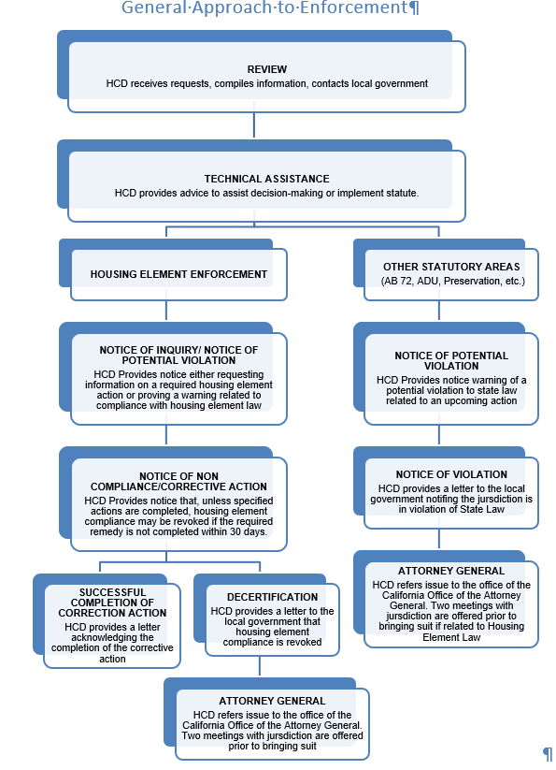
Moving from Technical Assistance to Enforcement
Notes:
[Mention different types of letters: TA, Letter of Support, Letter of Inquiry, HE non-compliance, NOPV, NOV, decertification, close-out]
TA regarding: ADUs, Specific policy issues , SLA, other state laws e.g., density bonus…

Slide 16
Resources
Housing Element Compliance:
TA – Contact your assigned reviewer
Building Blocks
Prohousing Program:
Prohousing Designation Program | California Department of Housing and Community Development
Accountability and Enforcement:
HAU Portal – HCD’s A & E webpage
ADU Portal – HCD’s ADU webpage
HousingElements@hcd.ca.gov
PublicLands@hcd.ca.gov
Preservation@hcd.ca.gov
Statewide and Regional Technical Assistance:
Technical Assistance: Accelerating Housing Production | California Department of Housing and Community Development
Experience (arcgis.com)

