Slide 1
City Leader Summit
April 2026
Securing our Water Supply Future

Slide 2
Moderator Remarks:
Councilmember
Rudy Mendoza
City of Woodlake

Slide 3
Opening Remarks:
Senator Melissa Hurtado
California State Senate District 16

Slide 4
Panelist:
Jennifer Pierre
Executive Director, State Water Contractors

Slide 5
Panelist:
Jerry Brown
Executive Director, Sites Project Authority

Slide 6

Sites Reservoir Project Update
April 23, 2026
Jerry Brown, Executive Director
Sites Project Authority

Slide 7
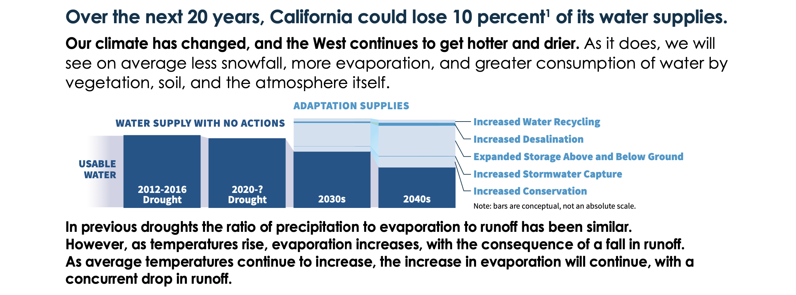
What Problem Does the Sites Project Help Solve?
Excerpted from Aug 2022 “California’s Water Supply Strategy, Adapting to a Hotter Drier Future”

Slide 8
General Project Update
Water Right – draft order issued March 19, 2026 and final by mid Sept 2026
Critical permits and approvals – ITP’s and BO (constr) received, 404/401 (wetlands) in progress, Sec 106/ROD complete
Construction Contractor Selections – underway
Land Acquisitions - ~ 90% of critical path project area acquired, TROEs being secured for enviro surveys
Engineering Design – completed to ~ 30% design, DSOD initial review complete (no red flags)
Cost Estimate and Schedule Update– cost updated in June 2025, schedule updated in January 2026
Financing – sources secured and loan agreements being negotiated
Off-Taker Contracts – in final negotiations
Notes:
Jerry

Slide 9
Sites Draft Water Right Permit was issued on 3/20/26
This is a major project milestone!
The draft permit finds water is available which confirms that Sites is a new water supply for California.
A permit of this magnitude for a new water supply has not occurred in decades and may not happen again.
Certain draft permit conditions may alter the project plans. Examples are:
  Additional diversion criteria and other limits on filling
  Uncertainties with the Bay Delta Plan Update
  Rights to local Creek water subject to further review
  Coordination to maintain South Delta water levels and quality when Sites water is exported
Sites Authority will be seeking changes in the permit prior to adoption in September 2026.

Slide 10
Current Allocation of Active Sites Storage Space
Participant Name | Storage Allocation | % Available Storage
Antelope Valley-East Kern WA | 3,117 | 0.2%
City of American Canyon | 24,936 | 1.8%
Coachella Valley WD | 62,340 | 4.4%
Colusa County | 62,340 | 4.4%
Colusa County WD | 57,702 | 4.1%
Cortina WD | 2,805 | 0.2%
Davis WD | 12,468 | 0.9%
Desert WA | 40,521 | 2.9%
Dunnigan WD | 18,527 | 1.3%
Glenn-Colusa ID | 31,170 | 2.2%
Irvine Ranch WD | 6,234 | 0.4%
LaGrande WD | 6,234 | 0.4%
Metropolitan Water District of SC | 311,700 | 22.1%
Reclamation District 108 | 24,936 | 1.8%
Rosedale-Rio Bravo WD | 3,117 | 0.2%
San Bernardino Valley Municipal WD | 133,408 | 9.5%
San Gorgonio Pass WA | 87,276 | 6.2%
Santa Clara Valley WD | 3,117 9,351 | 0.2% 0.6%
Santa Clarita Valley WA | 31,170 | 2.2%
Westside WD | 33,508 | 2.4%
Wheeler Ridge - Maricopa WSD | 19,014 12,780 | 1.3% 0.9%
Zone 7 WA | 62,340 | 4.4%
State of California - Total | 244,000 | 17.3%
Reclamation | 128,020 | 9.1%
Available Storage Total | 1,410,000 | 100.0%
At a glance:
North of Delta – 19.4%
South of Delta – 53.9%
Reclamation – 9.1%
State Prop 1 – 17.3%
We do expect more shifts in capacity as Participants make final funding decisions.
7

Slide 11
The Authority has a strategy for delivering the Project and managing risk
Contracting Strategy adopted in July 2022
Sites Authority
Partner Facilities
Stand Alone and Specialty
Reservoir
Facilities
Conveyance Facilities
Ownership
Operations
CMAR Conveyance – Procurement Coming in Spring 2026
2028 and Beyond
Dunnigan Pipeline
Huffmaster Road
Reservoir Clearing
Recreation
Hydraulics
Power
System Controls
O&M
Mitigation
Design-Build Terrestrial Compensatory Mitigation RFQ/RFP Currently Out For Bid
Logistics
Material Balance
Schedule
Community
CMAR Reservoir/Roads Awarded to Barnard on Jan 16, 2026
Notes:
9 Packages

Slide 12
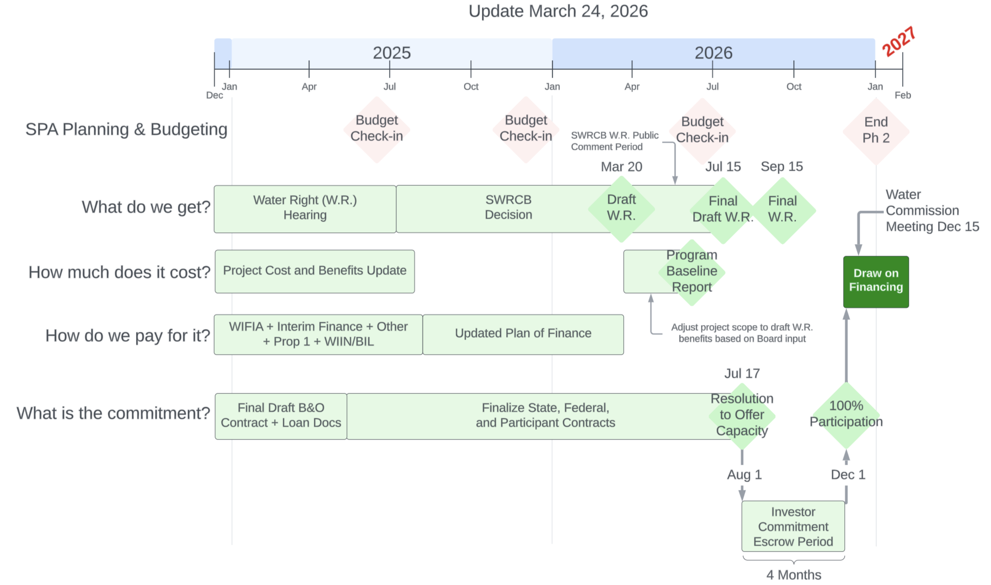
The draft water right brings more clarity to the near-term decision schedule

Slide 13
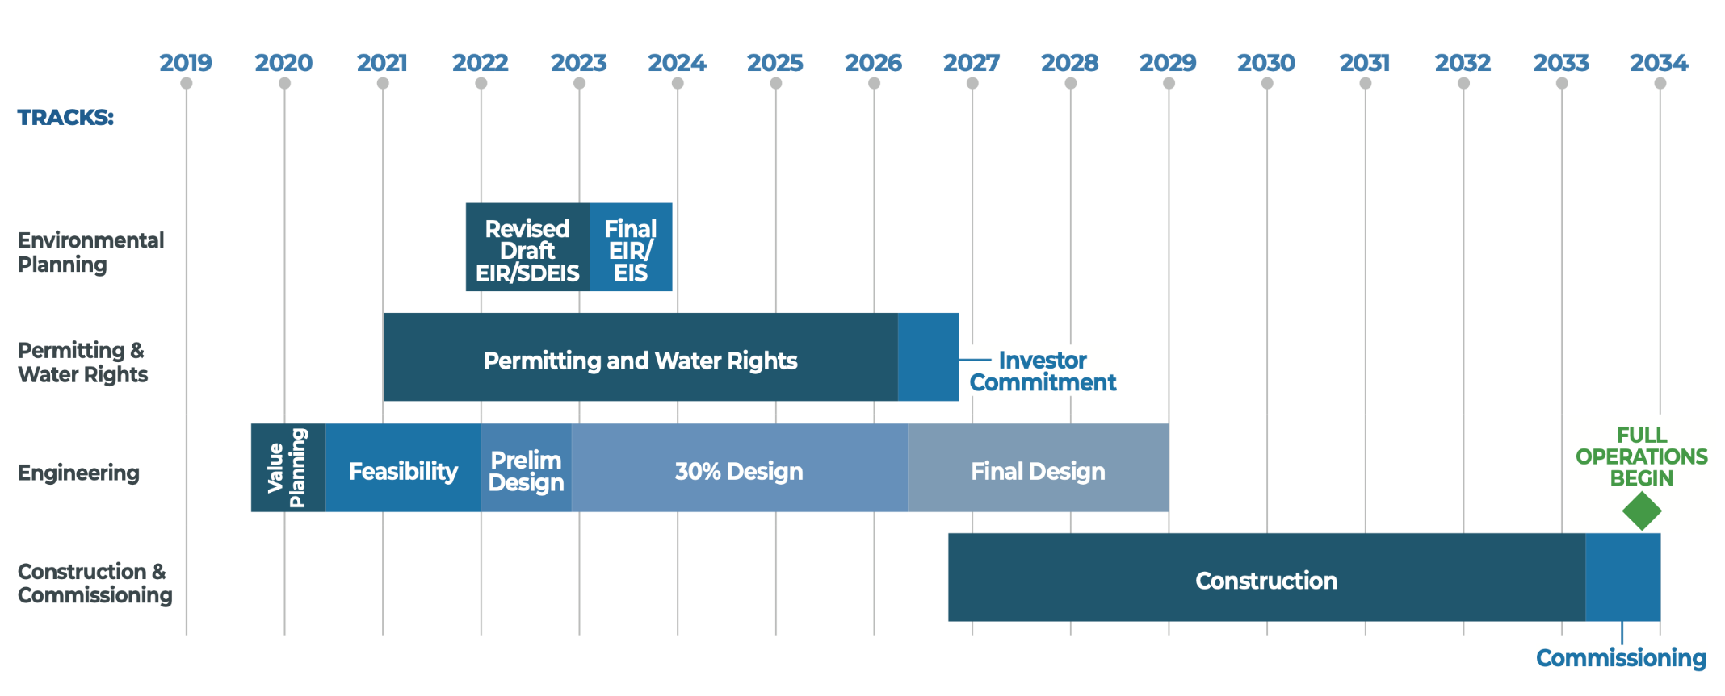
Timeline: Construction is on the Horizon
Sites Project Schedule (adopted January 2026)
Notes:
Jerry

Slide 14

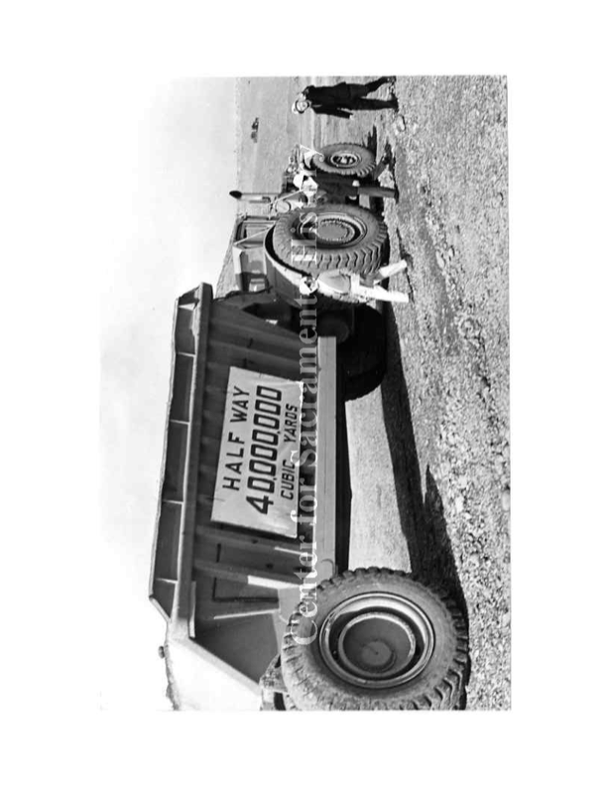
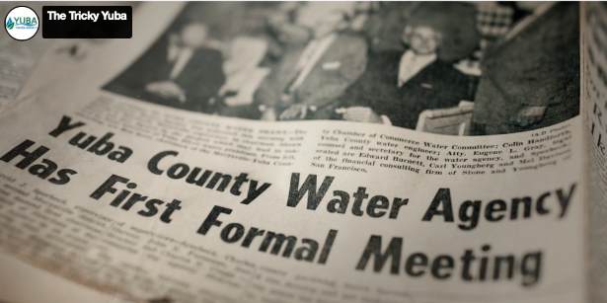
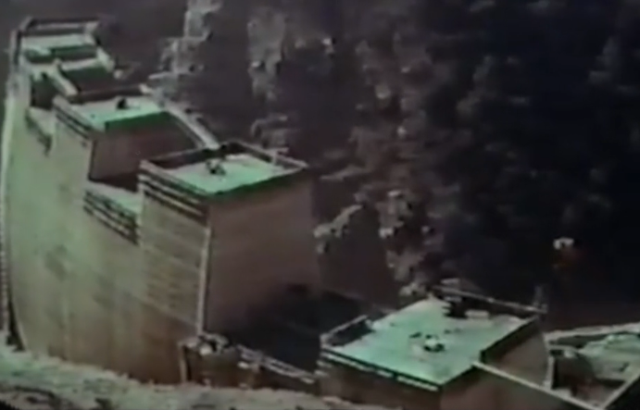
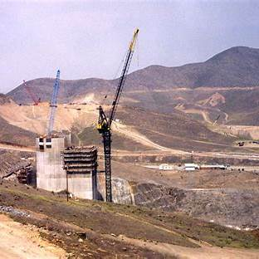
”Yuba County Voters Approved a measure pledging 2 times the Assessed Value of all land in the County to build New Bullards Bar Dam,”. (1961)
"California’s Bold Water Plan: $1.75 Billion State Water Project Sparks Debate on Cost and Feasibility"
(May 10, 1960)
”At $1.9B Diamond Valley Lake is a massive infrastructure investment. Questions raised whether costs justified.” (1991)

Slide 15
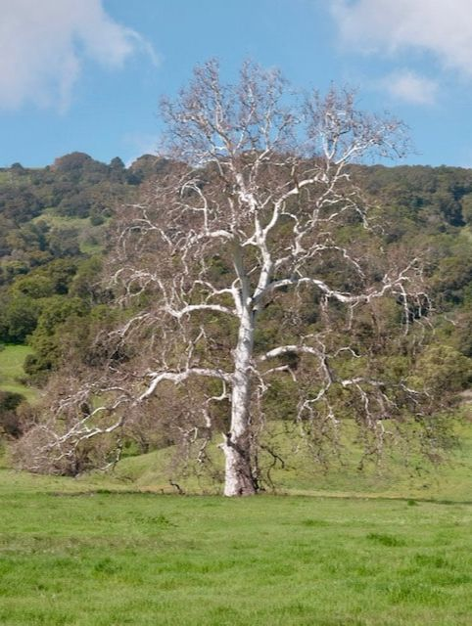
Closing
“A society grows great when old men and women plant trees in whose shadow they shall never sit “–
Greek Proverb

Slide 16
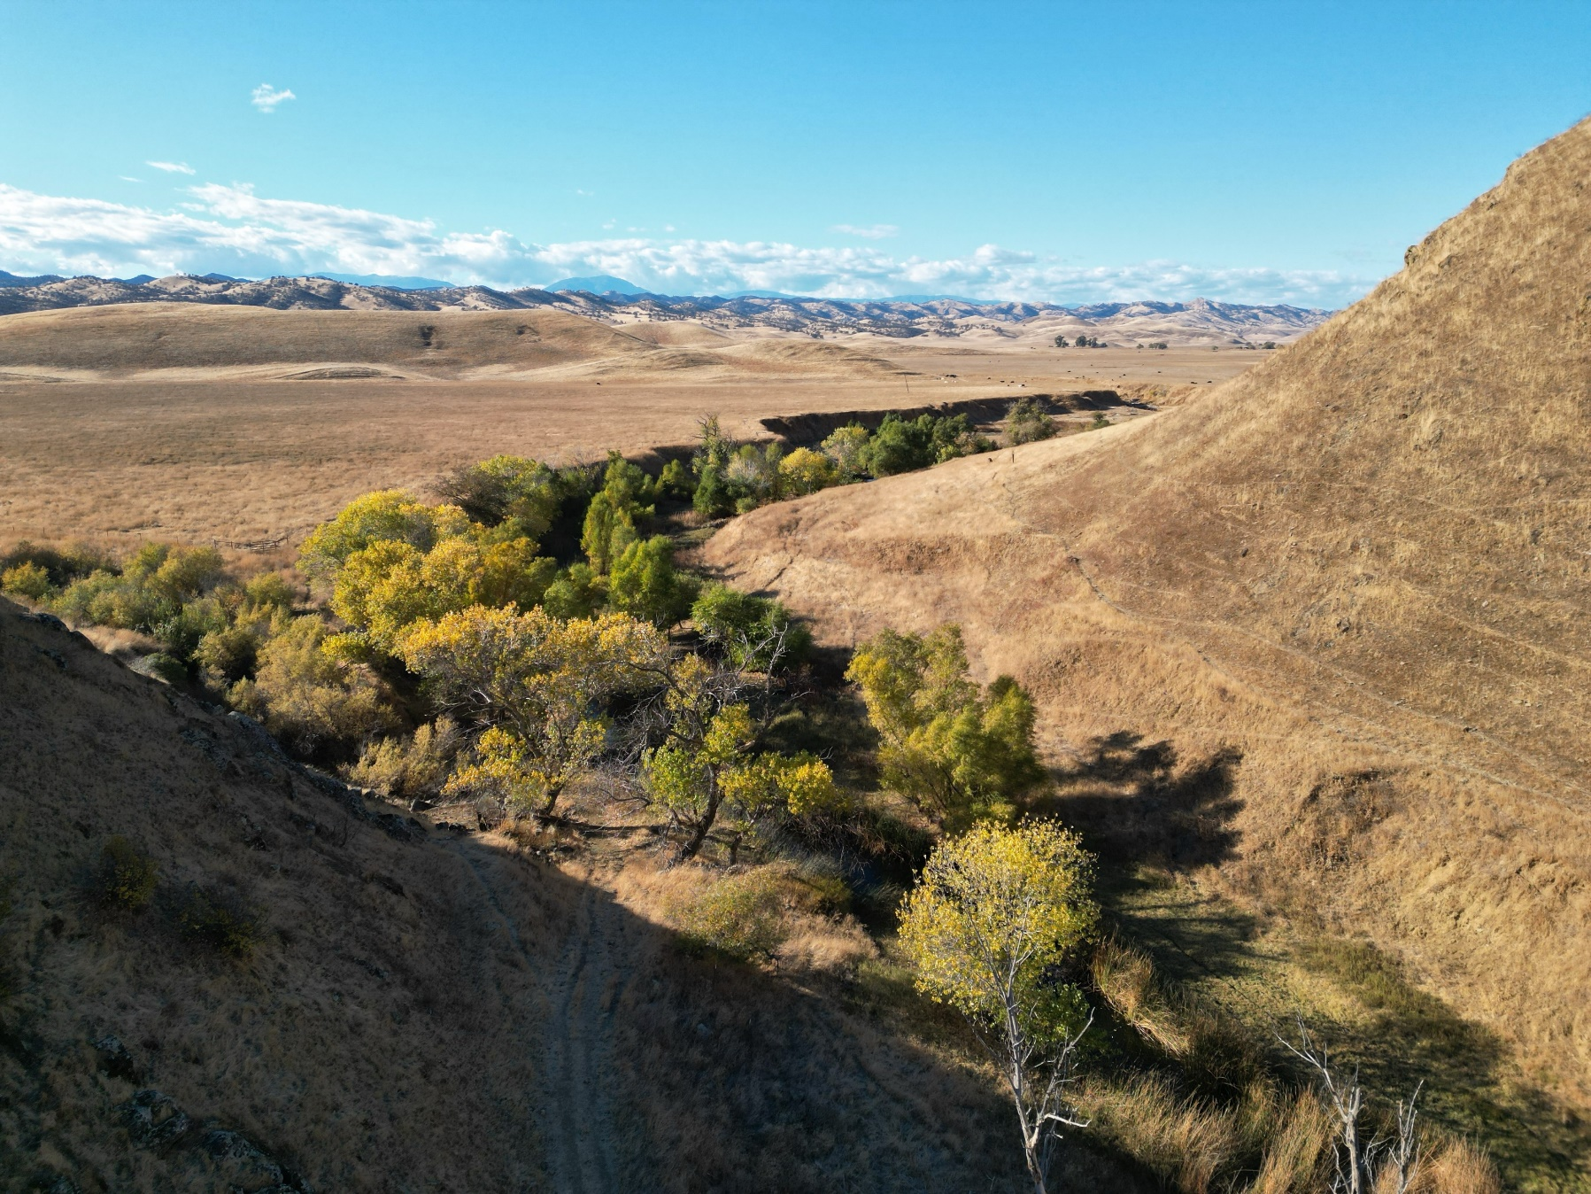
Questions?
October 28, 2025
Imported Water Subcommittee
24

