Slide 1
Webinars for Cities
July 22, 2021
Summer Recess Briefing on Priority Bills
Legislative Affairs Team

Slide 2
Housekeeping Notes
This session is being recorded.
Attendees are muted.
Question and Answer is available throughout the webinar.
Following the presentation, the recording will be shared with registrants.

Slide 3

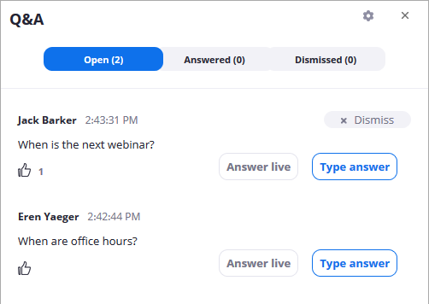
How to Ask a Question
To write in a question, select the Q&A button on your tool bar.
You can “upvote” other attendees’ questions. This brings the most popular questions to the top of the Q&A screen.

Slide 4
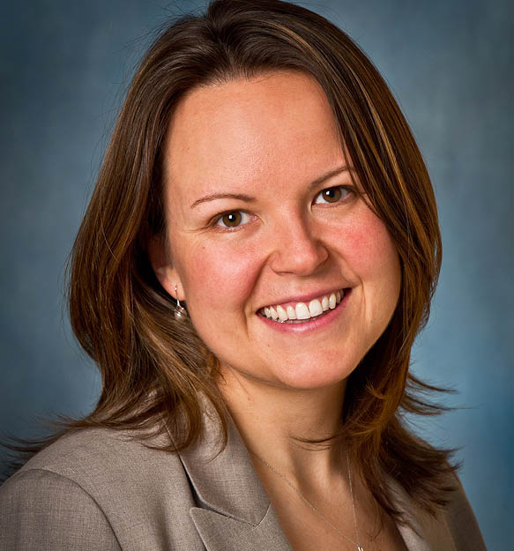
Moderator
Melanie Perron
  Deputy Executive Director, Advocacy and Public Affairs
  mperron@calcities.org

Slide 5
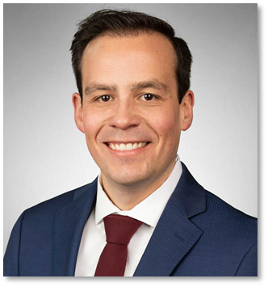
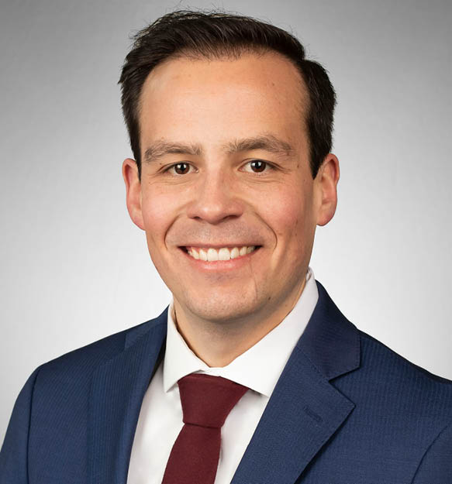
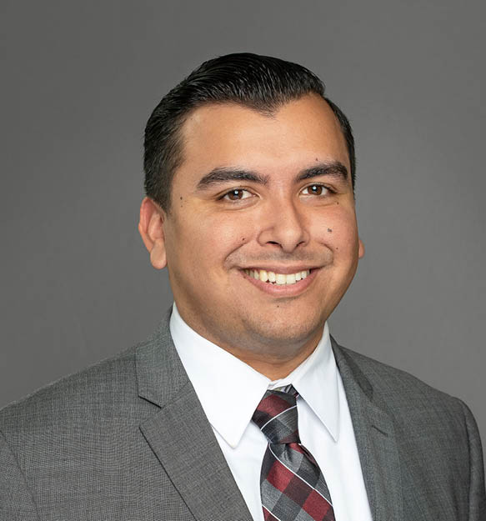
Presenters
Derek Dolfie
  Legislative Representative, Environmental Quality and Community Services
  ddolfie@calcities.org
Johnnie Pina
  Policy Analyst
  jpina@calcities.org

Slide 6
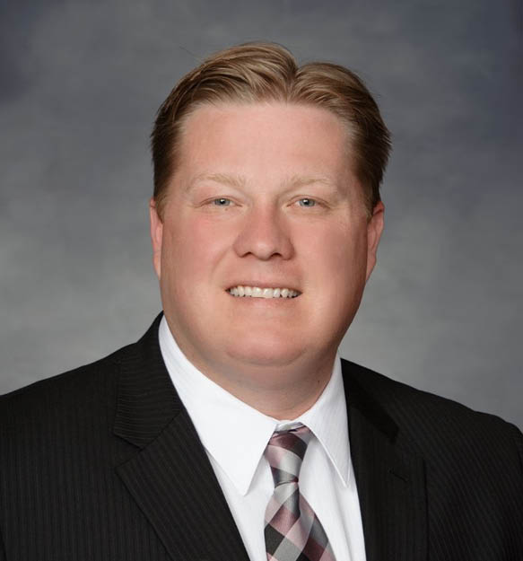
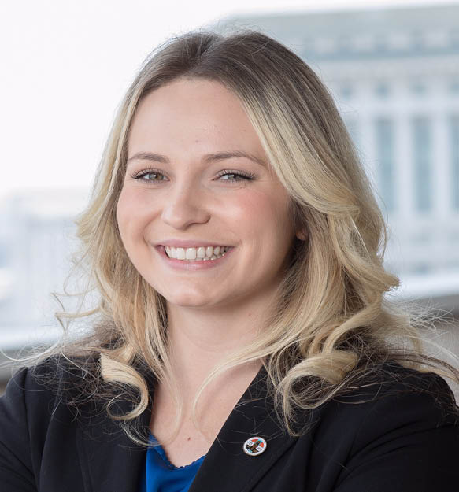
Presenters
Jason Rhine
  Assistant Legislative Director
  jrhine@calcities.org
Elisa Arcidiacono
  Legislative Representative, Public Safety
  earcidiacono@calcities.org

Slide 7
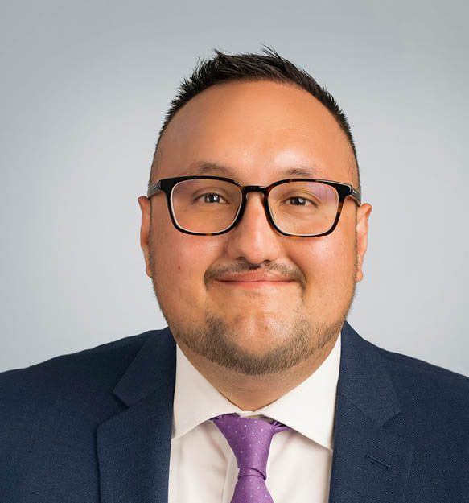
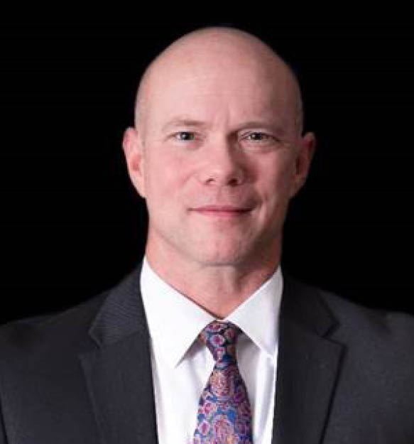
Presenters
Nick Romo
  Legislative Representative, Revenue and Taxation
  nromo@calcities.org
Damon Conklin
  Legislative Representative, Transportation, Communications, and Public Works
  dconklin@calcities.org

Slide 8
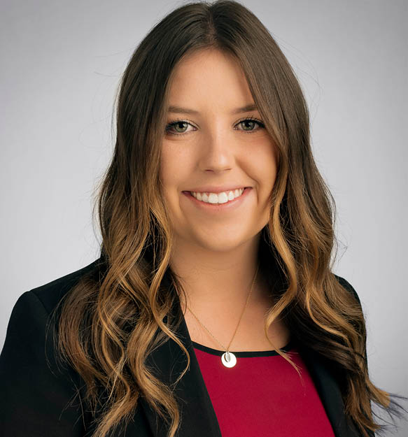
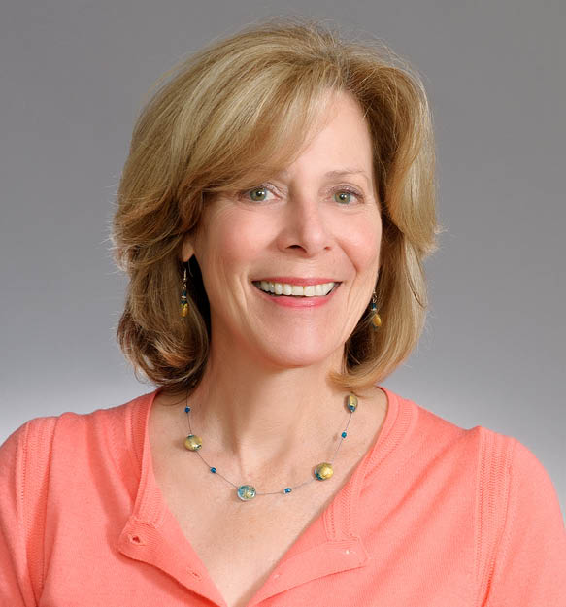
Presenters
Caroline Cirrincione
  Policy Analyst
  ccirrincione@calcities.org
Meg Desmond
  Legislative and Policy Development Specialist
  mdesmond@calcities.org

Slide 9
Agenda
Community Services
Environmental Quality
Governance, Transparency, and Labor Relations
Housing, Community, and Economic Development
Public Safety
Revenue and Taxation
Transportation, Communications and Public Works

Slide 10
Summer Recess Briefing
on Priority Bills
July 22, 2021
Community Services
Derek Dolfie
Legislative Affairs, Lobbyist
ddolfie@calcities.org

Slide 11
Disaster & Community Resiliency
AB 536 (Rodriguez) Office of Emergency Services. Mutual Aid Gap Analysis.
This measure would require California Office of Emergency Services (CalOES) to prepare a gap analysis of the state’s mutual aid systems on a biennial basis, beginning on January 1, 2022.
The measure would also require the gap analysis to be provided to specified committees of the Legislature no later than February 1, 2022, and by February 1 thereafter on a biennial basis.
Cal Cities Position: Support

Slide 12
Disaster & Community Resiliency
AB 1071 (Rodriguez) Office of Emergency Services. Tabletop Exercises.
This measure would require CalOES to biennially convene key government agencies, private businesses, nonprofit organizations, and lifeline operators to participate in tabletop exercises to discuss and evaluate the participant’s emergency preparedness plans under various simulated catastrophic disaster situations.
Cal Cities Position: Support if Amended

Slide 13
Homelessness
SB 344 (Hertzberg) Homeless Shelters Grants. Pets and Veterinary Services.
This measure would require the Department of Housing and Community Development to develop and administer a program to award grants to qualified homeless shelters for the provision of shelter, food, and basic veterinary services for pets owned by people experiencing homelessness.
Cal Cities Position: Support

Slide 14
Children, Child Care, and Youth Programs
AB 46 (Luz Rivas) California Youth Empowerment Act.
This measure would create the California Youth Empowerment Act to address the growing need to engage youth directly with policymakers.
The measure would also establish the California Youth Empowerment Commission in state government to provide meaningful opportunities for civic engagement to improve the quality of life for California’s disconnected and disadvantaged youth.
Cal Cities Position: Support

Slide 15
Children, Child Care, and Youth Programs
SB 50 (Limon) Early Learning and Care.
This measure would expand the range of types of childcare and early learning services that a state preschool contracting agency may provide.
Cal Cities Position: Support

Slide 16
Summer Recess Briefing
on Priority Bills
July 22, 2021
Environmental Quality
Derek Dolfie
Legislative Affairs, Lobbyist
ddolfie@calcities.org

Slide 17
Climate Change and Resiliency
AB 897 (Mullin) Office of Planning and Research. Regional Climate Networks. Climate Adaptation Action Plans.
This measure would authorize eligible entities, such as local governments, to establish and participate in a regional climate network and require the networks to develop and submit a climate action plan to the Office of Planning and Research (OPR).
The measure would require the OPR to develop guidelines and assistance to the establishment of such networks.
Cal Cities Position: Support

Slide 18
Climate Change and Resiliency
AB 585 (Luz Rivas) Climate Change. Extreme Heat and Community Resilience Program.
This measure would establish the Extreme Heat and Community Resilience Program within OPR to coordinate the state’s efforts to address extreme heat and facilitate the implementation of local, regional, and state planning efforts.
The measure would, upon appropriation from the Legislature, award competitive grants to eligible entities for implementation of those projects.
Cal Cities Position: Support

Slide 19
Energy and Utilities
SB 99 (Dodd) Community Energy Resilience Act of 2021.
This measure would require the Energy Commission (CEC) to develop and implement a grant program for local governments to develop community energy resilience plans. The measure would also require the CEC to develop and adopt project evaluation guidelines for applicants to submit a funding proposal to develop a community energy resilience plan.
If a local government receives funding from this program they must:
Conduct an analysis of critical facilities, identify areas most likely to experience loss of power, and include a preliminary feasibility analysis of expected costs and benefits for anticipated projects in the city.
Cal Cities Position: Support

Slide 20
Sea Level Rise and Coastal Issues
SB 1 (Atkins) Coastal Resources. Sea Level Rise.
This measure would direct the California Coastal Commission to take into account sea level rise in its coastal planning, development, and mitigation efforts; establish a collaborative within the Ocean Protection Council to help provide local and regional planning and mitigation strategies for sea level rise; and would make public funding available both for local sea level rise planning efforts, and for community outreach and education for disadvantaged communities along the coast.
Cal Cities Position: Support

Slide 21
Sea Level Rise and Coastal Issues
SB 418 (Laird) Sea Level Rise Planning. Database.
This measure would extend the sunset date for OPR’s Planning for Sea Level Rise Database by five years from Jan 1, 2023 to Jan 1, 2028.
Cal Cities Position: Support

Slide 22
Solid Waste and Recycling
AB 1311 (Wood) Recycling. Beverage Containers.
This measure would expand beverage container redemption opportunities under the California Beverage Container
Recycling and Litter Reduction Act.
Cal Cities Position: Support

Slide 23
Solid Waste and Recycling
SB 619 (Laird) Organic Waste. Reduction Regulations
This measure is aiming to help local governments implement SB
1383 (Lara, 2016) and the subsequent CalRecycle organic waste regulations.
Cal Cities Position: Support

Slide 24
Toxic Materials
AB 332 (Committee on Environmental Safety and Toxic Materials) Hazardous Waste. Treated Wood Waste. Management Standards.
This measure would authorize treated wood waste to be managed under alternative management standards instead of as a hazardous waste.
Cal Cities Position: Support

Slide 25
Questions?
Derek Dolfie
Legislative Affairs, Lobbyist
ddolfie@calcities.org • 916-658-8218

Slide 26
Summer Recess Briefing
on Priority Bills
July 22, 2021
Governance, Transparency, and Labor Relations
Johnnie Pina
Legislative Policy Analyst
Jpina@calcities.org

Slide 27
Brown Act
AB 339 (Lee) Local Government. Open and Public Meetings.
This measure would require, until December 31, 2023, city councils and boards of supervisors in jurisdictions with over 250,000 residents provide both in-person and a two-way telephonic option or a two-way internet-based service option for the public to attend their meetings.
Cal Cities Position: Oppose

Slide 28
Brown Act
AB 361 (Rivas, Robert) Open Meetings. Local Agencies. Teleconferences.
This measure would authorize local agencies to meet remotely during declared state emergencies to ensure continued delivery of critical public services.
Cal Cities Position: Support

Slide 29
Labor Relations
AB 654 (Reyes) COVID-19. Exposure. Notification.
This measure would revise the notice requirements to compel publication of site-specific publication of where outbreaks of COVID-19 occur.
Cal Cities Position: Oppose

Slide 30
Labor Relations
AB 237 (Gray) Public Employment. Unfair Practices. Health Protection.
This measure would prohibit public employers from terminating, or threatening to terminate, the health care coverage and related benefits of employees and their families during an authorized strike, and grants the Public Employee Relations Board (PERB) jurisdiction to enforce this prohibition.
Cal Cities Position: Oppose

Slide 31
Labor Relations
SB 270 (Durazo) Public Employment. Labor Relations. Employee Information.
This measure would authorize a public employee bargaining representative to file an unfair labor practice claim with PERB if a public employer fails to provide certain employee information in a timely and accurate manner. This measure would subject the employer to civil penalties and a prevailing party’s attorney’s fees and costs.
Cal Cities Position: Oppose

Slide 32
Workers’ Compensation
SB 284 (Stern) Workers’ Compensation. Firefighters and Peace Officers. Post-traumatic Stress.
This measure would expand California’s current presumption for Post Traumatic Stress Disorder (PTSD) for police officers and firefighters, to cover public safety dispatchers, public safety telecommunications, and emergency response communication employees.
Cal Cities Position: Oppose

Slide 33
CalPERS
SB 278 (Leyva) Public Employees’ Retirement System. Disallowed Compensation. Benefit Adjustments.
This measure would require a public employer to cover the cost difference between a retiree’s pension as originally calculated and as reduced by California Public Employees’ Retirement System (CalPERS) in situations where CalPERS reduces a retiree’s pension post-retirement due to CalPERS determining that inclusion of compensation agreed to under a collective bargaining agreement is nonpensionable.
Cal Cities Position: Oppose

Slide 34
Questions?
Johnnie Pina
Legislative Policy Analyst
jpina@calcities.org • 916-658-8214

Slide 35
Summer Recess Briefing
on Priority Bills
July 22, 2021
Housing, Community and Economic Development
Jason Rhine
Assistant Director, Legislative Affairs
jrhine@calcities.org

Slide 36
Planning and Zoning
SB 8 (Skinner) Housing Crisis Act of 2019.
This measure would extend the sunset date for the Housing Crisis Act of 2019 from 2025 to 2030. The Housing Crisis Act declared a statewide housing crisis and froze nearly all development-related fees once a developer submits a “preliminary” application, including essential project specific fees.
Cal Cities Position: Oppose

Slide 37
Planning and Zoning
SB 9 (Atkins) Housing Development Approvals.
This measure would require a local government to ministerally approve a housing development containing two residential units in single-family zones. Additionally, this measure would require local governments to ministerally approve urban lot split.
Cal Cities Position: Oppose

Slide 38
Planning and Zoning
AB 215 (Chiu) Housing Element.
This measure would require cities to have a mid-cycle housing element consultation with the Department of Housing and Community Development (HCD) if housing production is below the regional average; require cities to amend their laws so as to attain HCD’s “pro-housing designation” if housing production is substantially below the regional average; and allow the Attorney General to enforce violations of the Housing Crisis Act of 2019 (SB 330, Skinner).
Cal Cities Position: Oppose

Slide 39
Planning and Zoning
AB 500 (Ward) Local Planning. Permitting. Coastal Development
This measure would require the California Coastal Commission to conduct and complete a study on or before January 1, 2023, that identifies recommendations for policy changes that advance affordable housing in the coastal zone. The study may include recommendations regarding the Commission’s authority related to the development of lower income housing and recommendations regarding streamlining of local government and commission review of affordable housing projects.
Cal Cities Position: Oppose – Reconsidering based on amendments

Slide 40
Planning and Zoning
AB 989 (Gabriel) Housing Appeals Committee.
This measure would create an Office of Housing Appeals within HCD to review allegations of violations of the Housing Accountability Act (HAA) for specified housing developments projects.
Cal Cities Position: Oppose

Slide 41
Planning and Zoning
AB 1401 (Friedman) Residential and Commercial Development. Parking Requirements.
This measure would prohibit local governments from imposing or enforcing a minimum automobile parking requirement for residential, commercial and other developments if the parcel is located within one-half mile walking distance of public transit.
Cal Cities Position: Oppose

Slide 42
Mitigation Fee Act
AB 602 (Grayson) Development Fees.
This measure would make significant changes to laws
governing local development impact fees and create new state and local costs.
Cal Cities Position: Oppose Unless Amended

Slide 43
Miscellaneous – Two Year Bills/Gut and Amend
AB 816 (Chiu) Homelessness. Housing Trust Fund.
SB 15 (Portantino) Idle Retail Sites.
SB 6 (Caballero) Local Planning. Housing in Commercial Zones.

Slide 44
Questions?
Jason Rhine
Assistant Director
jrhine@calcities.org • 916-658-8264

Slide 45
Summer Recess Briefing
on Priority Bills
July 22, 2021
Public Safety
Elisa Arcidiacono
Legislative Affairs, Lobbyist
earcidiacono@calcities.org

Slide 46
Peace Officer Certification
AB 89 (Jones-Sawyer) Peace Officers. Minimum Qualifications.
This measure would increase the minimum qualifying age from 18 to 21 years of age for peace officer certifications and would, on and after January 1, 2025, require new officers to complete the curriculum or degree program developed by the Commission on Peace Officer Standards and Training (POST) or to have a bachelor’s degree or other advanced degree from an accredited college or university.
Cal Cities Position: Oppose (prior to 7/15 amendments)

Slide 47
Peace Officer Decertification
SB 2 (Bradford) Peace Officers. Certification. Civil Rights.
This measure would establish new standards and processes for decertifying peace officers, and would eliminate the application of certain governmental immunities and allow wrongful death actions under the Tom Bane Civil Rights Act.
Cal Cities Position: Oppose

Slide 48
Peace Officer Record Disclosure
SB 16 (Skinner) Peace Officers. Release of Records.
This measure would expand the categories of records subject to disclosure under the California Public Records Act (CPRA); impose new requirements for record retention specify a timeline for a law enforcement agency to provide public records to the requester; and would outline restrictions related to attorney-client privilege.
Cal Cities Position: Oppose (prior to 7/8 amendments)

Slide 49
Law Enforcement Tools
AB 48 (Gonzalez) Law Enforcement: Kinetic Energy Projectiles and Chemical Agents.
This measure would prohibit use of kinetic energy projectiles and chemical agents by law enforcement agencies to disperse assemblies, protests, or demonstrations. This measure would further mandate these tools only be utilized to defend against a threat to life or serious bodily injury.
Cal Cities Position: Oppose

Slide 50
Law Enforcement Settlement Reporting
AB 603 (McCarty) Law Enforcement Settlements and Judgments. Reporting.
This measure would require municipalities to annually post on their websites specified information relating to settlements and judgments resulting from allegations of improper police conduct, including, among other information, amounts paid, broken down by individual settlement and judgment, information on bonds used to finance use of force settlement and judgment payments, and premiums paid for insurance against settlements or judgments resulting from allegations of improper police conduct.
Cal Cities Position: Oppose

Slide 51
Law Enforcement Investigations
AB 718 (Cunningham) Peace Officers: Investigations of Misconduct.
This measure would require a law enforcement agency to complete its investigation into an allegation of misconduct despite the peace officer’s or custodial officer’s voluntary separation from the employing agency. This measure would also require disclosure of the investigative findings.
Cal Cities Position: Support

Slide 52
Post-Pandemic Relief
SB 314 (Wiener) Alcoholic Beverages.
This measure would authorize the Department of Alcohol Beverage Control (ABC) flexibility around catering licenses and requirements for licensees to share a main common area for
business. This measure would create an extended timeline for licensees with expanded premises to make their expansion permanent and extend the event application window.
Cal Cities Position: Support if Amended

Slide 53
Post-Pandemic Relief
AB 61 (Gabriel) Business Pandemic Relief.
This measure would authorize the Department of Alcohol Beverage Control (ABC) flexibility around catering licenses and requirements for licensees to share a main common area for
business. This measure would create an extended timeline for licensees with expanded premises to make their expansion permanent and extend the event application window.
Additionally, this measure would authorize a permitted food facility to prepare and serve food as a temporary satellite food service without obtaining a separate satellite food service permit.
Cal Cities Position: Support if Amended

Slide 54
Post-Pandemic Relief
SB 389 (Dodd) Alcoholic beverages: retail off-sale license: retail off-sale delivery: retail on-sale license: off-sale privileges.
This measure would authorize the holder of a retail on-sale license or a licensed beer manufacturer operating a bona fide eating place to exercise additional off-sale rights and privileges and authorize the sale of alcoholic beverages for off-sale consumption and delivery.
Cal Cities Position: Support if Amended

Slide 55
Card Rooms
SB 576 (Archuleta) Gambling: Local Moratorium.
This measure would extend, until January 2028, a moratorium on brick-and-mortar card room expansion. It would additionally allow locals to amend their ordinance to increase the number of gambling tables that may be operated in a gambling establishment by up to two tables each calendar year, up to a maximum total of 10 additional tables.
Cal Cities Position: Oppose

Slide 56
Fireworks
SB 277 (Archuleta) Fireworks. Dangerous Fireworks. Seizure. Management.
This measure would expand the definition of what is considered to be a dangerous firework, and would create a uniform statewide
management policy regarding safe seizure, storage, repurposing, destruction, or disposal of federally approved dangerous fireworks and California, classified safe and sane fireworks.
Cal Cities Position: Support if Amended

Slide 57
Questions?
Elisa Arcidiacono
Legislative Affairs, Lobbyist
earcidiacono@calcities.org • 916-720-8025

Slide 58
Summer Recess Briefing
on Priority Bills
July 22, 2021
Revenue and Taxation
Nick Romo
Legislative Affairs, Lobbyist
nromo@calcities.org

Slide 59
Short-Term Rentals
SB 60 (Glazer) Short-Term Rental Ordinance Violations.
This measure would allow cities and counties to impose larger fines for violations of short-term rental ordinances up to $5,000 for each violation. The violations must be deemed to pose threat to public health and safety. This increased allowance would not apply to the first failure to register or pay a business license fee.
Cal Cities Position: Support

Slide 60
Short-Term Rentals
SB 555 (McGuire) State Sponsored Short-Term Rental Tax Collection Program
This measure would authorize a local agency to delegate its authority to collect their locally imposed transient occupancy tax (TOT) and fees on short term rentals to the California Department of Tax and Fee Administration (CDTFA). This measure would allow short-term rental platforms to conceal rental locations, rates, and stay durations from CDTFA and contracting agencies reducing audit capabilities.
Cal Cities Position: Oppose Unless Amended

Slide 61
Post-Redevelopment Tools
SB 780 (Cortese) Public Investment Authorities.
This measure would provide improved flexibility and capacity to Enhanced Infrastructure Financing Districts and Community Revitalization and Investment Authorities aimed at increasing investor confidence and ease of administration.
Cal Cities Position: Support

Slide 62
Online Sales Tax Reporting
SB 792 (Glazer) Sales and Use Tax. Retailer Reporting.
This measure would require online retailers, with annual taxable sales exceeding $50 million, to report to CDTFA certain taxing jurisdiction information of where a product, purchased online, is shipped.
Cal Cities Position: Support

Slide 63
Questions?
Nick Romo
Legislative Affairs, Lobbyist
nromo@calcities.org • 916-658-8232

Slide 64
Summer Recess Briefing
on Priority Bills
July 22, 2021
Transportation, Communications, and Public Works
Damon Conklin
Legislative Affairs, Lobbyist
DConklin@calcities.org

Slide 65
Local Streets and Roads
AB 43 (Freidman) Speed Limits.
This measure would grant local authorities greater flexibility in setting speed limits on the most dangerous local streets.
Cal Cities Position: Support

Slide 66
Local Streets and Roads
AB 773 (Nazarian) Street Closures and Designations.
This measure would authorize cities to adopt a rule or regulation to designate a local street within its jurisdiction as a slow street, where thru traffic would be banned, limiting speeds so people could use the pavement for individual and community benefits.
Cal Cities Position: Support

Slide 67
Electrical Vehicle Charging
AB 970 (McCarty) Planning and Zoning. Electric Vehicle Charging Stations. Permit Application. Approval.
This measure would create a 15-day deemed approved permit shot clock for electric vehicle charging stations.
Cal Cities Position: Oppose

Slide 68
California Advanced Services Fund
AB 14 (Aguiar-Curry) Broadband Services. California Advanced Services Fund.
SB 4 (Gonzalez) Communications. California Advanced Services Fund. Deaf and Disabled Telecommunications Program. Surcharges.
These measures would reform the existing California Advanced Services Fund (CASF) surcharge to help close the digital divide. Specifically, these measures would:
Continue to fund CASF beyond the original 2022 sunset date;
Make it easier for local governments to apply for these grants;
Expand the definition of unserved; and
Develop a model for streamlined permits through the Governor’s Office of Business and Economic Development.
Cal Cities Position: Support

Slide 69
California Advanced Services Fund
SB 28 (Caballero) Rural Broadband and Digital Infrastructure Video Competition Reform Act of 2021.
This measure would require state departments and agencies to create an inventory of resources that could be used for broadband expansion. This measure would also ensure communities have negotiating power with service providers regarding broadband services.
Cal Cities Position: Support

Slide 70
Broadband Permitting
SB 556 (Dodd) Street Light Poles, Traffic Signal Poles, Utility Poles, and Support Structures. Attachments.
This measure would require local governments to make space available on street light poles, traffic signal poles, utility poles, and other public infrastructure to telecommunications providers in accordance with the Federal Communications Commission's adopted regulations on wireless services deployment.
Cal Cities Position: Oppose

Slide 71
Telecommunications
SB 341 (McGuire) Telecommunications Service. Outages.
This measure would require the Office of Emergency Services (Cal OES) to adopt regulations for public outage maps maintained by telecommunications providers.
Additionally, SB 341 would require the California Public Utilities Commission and Cal OES to develop backup electrical supply rules to require telecommunications providers to maintain service for at least 72 hours.
Cal Cities Position: Support

Slide 72
Questions?
Damon Conklin
Legislative Affairs, Lobbyist
DConklin@calcities.org • 916-290-3400

Slide 73
Thank you
Melanie Perron
Deputy Executive Director,
Advocacy and Public Affairs
mperron@calcities.org

