Slide 1
Proposition 4
November 2024 Ballot
[Insert Logo]

Slide 2
Prop. 4: The Safe Drinking Water, Wildfire Prevention, Drought Preparedness, and Clean Air Bond Act of 2024
TOTAL – $10 BILLION
Water – $3.8 billion
Wildfire Preparedness and Forest Resilience – $1.5 billion
Coastal Resilience – $1.2 billion
Extreme Heat – $450 million
Biodiversity Protection – $1.2 billion
Climate-Smart and Sustainable Agriculture – $300 million
Parks and Outdoor Access – $700 million
Clean Air and Energy – $850 million

Slide 3
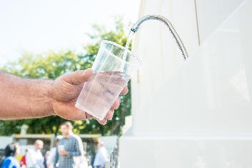
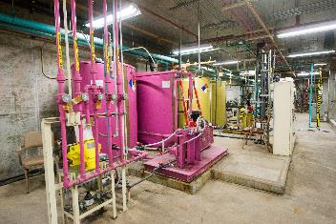
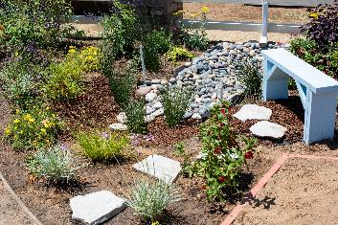
Water Resilience Chapter
Water resilience ($3.8 billion)
  Safe, clean, and reliable water including monitoring for PFAS: $610 million
  Groundwater sustainability: $386 million
  Multi-benefit land repurposing: $200 million
  Water recycling: $386 million
  Water storage: $75 million
  Brackish desalination: $62.5 million
  Water data management: $15 million
  Regional conveyance: $75 million
  Water conservation: $75 million
  Flood management: $550 million
  Dam safety and reservoir operations: $480 million
  Stormwater capture and reuse: $110 million
  Integrated regional water management: $100 million
  Watershed management: $335 million
  Salton Sea: $170 million
  Stream protection and enhancement: $150 million
  Zoos and aquariums: $20 million (additional funding also included in the Parks and Outdoor Access Chapter)

Slide 4
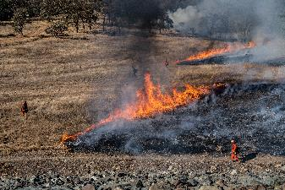
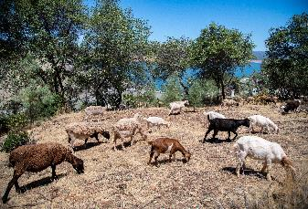
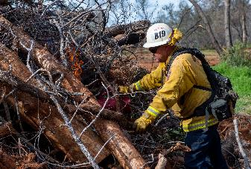
Wildfire and Forest Resilience Chapter
Wildfire and forest resilience ($1.5 billion)
  Wildfire mitigation: $135 million
  State and local wildfire prevention: $1.205 billion
  (includes wildfire funding for conservancies)
  Vegetative waste removal: $50 million
  Fire detection technology: $25 million
  Electricity transmission wildfire risk: $35 million
  Workforce development: $50 million

Slide 5
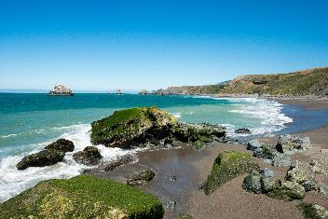
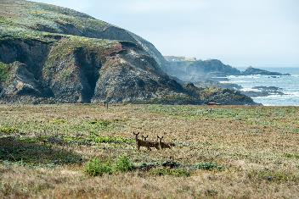
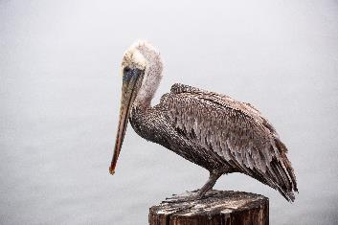
Coastal Resilience Chapter
Coastal resilience ($1.2 billion)
  Coastal resiliency: $415 million
  Coastal and flood management: $350 million
  Marine ecosystems: $135 million
  Sea level rise mitigation: $75 million
  Sea level rise adaptation: $50 million
  Fisheries management and ecosystems: $75 million
  Dam removal: $75 million
  Fish hatcheries: $25 million

Slide 6

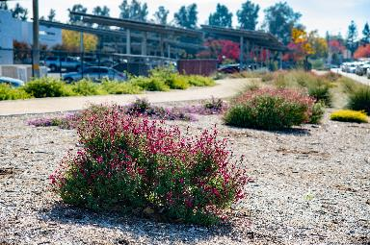
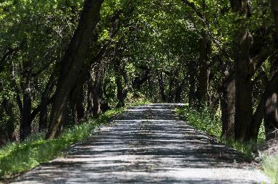
Extreme Heat Mitigation Chapter
Extreme heat mitigation ($450 million)
  Extreme heat and community resilience: $50 million
  Transformative climate communities: $150 million
  Urban greening: $100 million
  Urban forests: $50 million
  Community resilience centers: $60 million
  Fairground modifications: $40 million

Slide 7
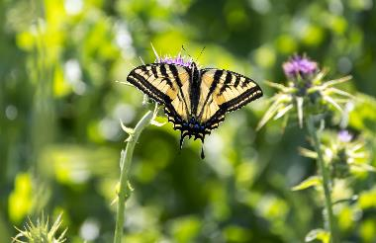
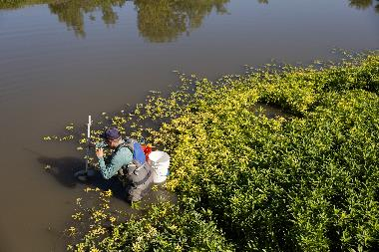
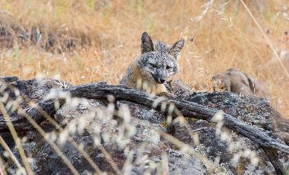
Protect Biodiversity Chapter
Protect biodiversity ($1.2 billion)
  Biodiversity protection, native landscaping, invasive species control, wildlife crossings and corridors, and protection of natural pollinators: $870 million
  Regional conservancies: $320 million
  Tribal nature-based solutions: $10 million

Slide 8
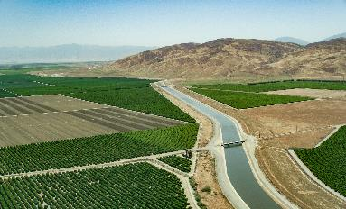
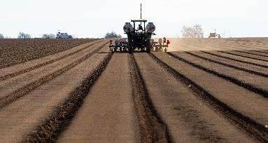
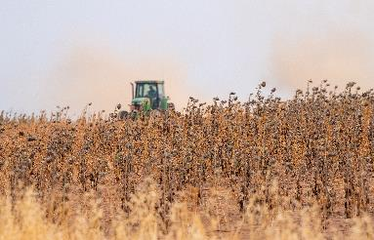
Climate-Smart Agriculture Chapter
Climate-smart agriculture ($300 million)
  Climate resilient agricultural lands: $105 million
  Invasive species: $20 million
  Farmland and rangeland: $15 million
  Sustainable infrastructure: $90 million
  Land access: $30 million
  Agricultural vanpool: $15 million
  Farm research: $15 million
  Farmworker housing energy efficiency: $10 million

Slide 9
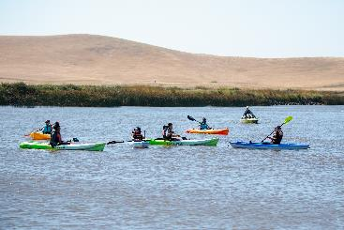
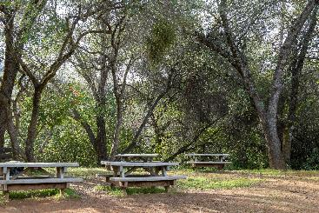
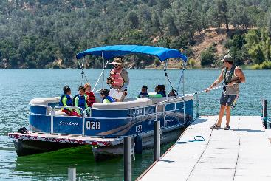
Parks and Outdoor Access Chapter
Parks, outdoor, and climate resilience ($700 million)
  Safe neighborhood parks: $200 million
  Outdoor and recreational access: $200 million
  State park and trail enhancement: $100 million
  State park maintenance: $175 million
  Zoos & aquariums: $25 million

Slide 10
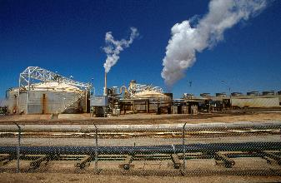
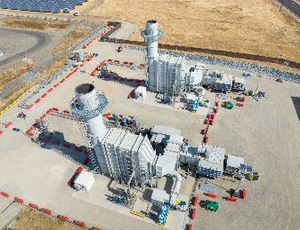
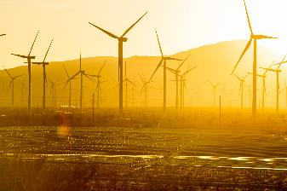
Clean Air Chapter
Energy ($850 million)
  Clean energy transmission: $325 million
  Long-term battery storage projects: $50 million
  Off-shore wind generation: $475 million

