Slide 1
Webinars for Cities
May 12, 2025
Appropriations Watch: Key Bills for Cities
Speakers:
Cal Cities Legislative Team

Slide 2
Housekeeping Notes
This session is being recorded
Attendees are muted
Q&A is available throughout the webinar
To write in a question, select the Q&A button on your tool bar
Following the presentation, the recording and slides will be shared with registrants

Slide 3




CALL FOR PROPOSALS
CONFERENCE
AND EXPO
OCTOBER 8 -10, 2025
LONG BEACH, CA

Slide 4
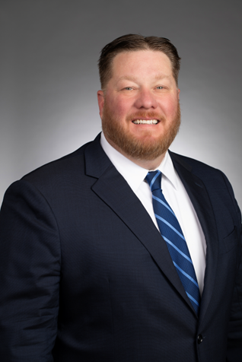
Jason Rhine
Senior Director, Legislative Affairs
League of California Cities

Slide 5
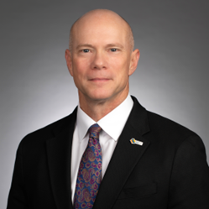
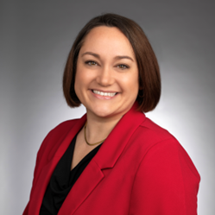
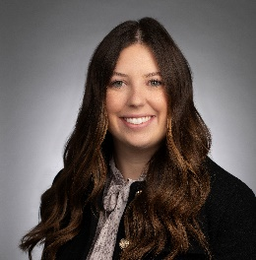
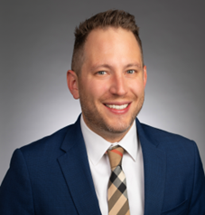
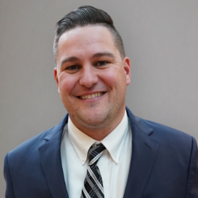
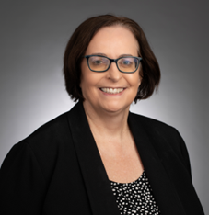
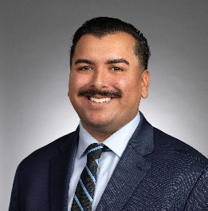
Lobbyists
Damon Conklin
Legislative Advocate, Transportation, Communications, and Public Works
dconklin@calcities.org
Melissa Sparks-Kranz
Legislative Advocate, Environmental Quality
msparkskranz@calcities.org
Caroline Grinder
Legislative Advocate,
Community Services
cgrinder@calcities.org
Ben Triffo
Legislative Advocate,
Revenue and Taxation
btriffo@calcities.org
Brady Guertin
Legislative Advocate, Housing, Community, and Economic Development
bguertin@calcities.org
Jolena Voorhis
Legislative Advocate,
Public Safety
jvoorhis@calcities.org
Johnnie Pina
Legislative Advocate, Governance, Transparency, and Labor Relations
jpina@calcities.org

Slide 6

Agenda
Transportation, Communications, and Public Works
Revenue and Taxation
Public Safety
Housing, Community, and Economic Development
Governance, Transparency, and Labor Relations
Environmental Quality
Community Services

Slide 7
Key dates and deadlines
Assembly and Senate Appropriations Committees will meet May 12 - May 22 (submit letters/ make calls)
On May 23, the Assembly and Senate Appropriations Committees will consider bills on the “suspense file”
Bills that make it out of committee will be sent to the Assembly or Senate Floor
Floor session only June 2- June 6

Slide 8
Transportation, Communications, and Public Works
Damon Conklin
Legislative Advocate
dconklin@calcities.org • 916-658-8234

Slide 9
Infrastructure
SB 496 (Hurtado) Advanced Clean Fleets: reforms.
This measure would create a new appeals process and provide much needed and common-sense reforms to the ACF Regs.
Cal Cities Position: Sponsor

Slide 10
Transportation
AB 1022 (Kalra) Parking: ability to tow.
This measure would severely limit cities' ability to enforce parking regulations, causing a cascade of fiscal damage: lost revenue, increased administrative costs, decreased compliance, harm to local businesses, public safety risks, and overall reduced effectiveness of municipal government operations.
Cal Cities Position: Oppose

Slide 11
Questions?
Damon Conklin
Legislative Advocate
dconklin@calcities.org • 916-658-8234

Slide 12
Revenue and Taxation
Ben Triffo
Legislative Advocate
btriffo@calcities.org • 916-738-9062

Slide 13
Sales and use tax exemption
SB 86 (McNerney): California Alternative Energy and Advanced Transportation Financing Authority Act: sales and use tax exclusion.
This measure would permanently extend and increase the sales tax exemption authorized under the Act from $100 to $300 annually.
Cal Cities Position: Oppose

Slide 14
Property tax exemption
SB 710 (Blakespear): Property taxation: active solar energy systems: extension.
This measure would permanently extend the property tax exemption for installation of solar energy systems on homes and businesses.
Cal Cities Position: Concerns/Pending

Slide 15
Questions?
Ben Triffo
Legislative Advocaate
btriffo@calcities.org • 916-738-9062

Slide 16
Public Safety
Jolena Voorhis
Legislative Advocate
jvoorhis@calcities.org • 916-658-8252

Slide 17
Fire insurance/wildfires
AB 1 (Connolly) Residential property insurance: wildfire risk.
This measure would require the Department of Insurance to include wildfire mitigation in the next draft of the Catastrophe Modeling regulations.
Cal Cities Position: Support

Slide 18
Fire insurance/wildfires
AB 888 (Calderon) California Safe Homes Grant Program.
This measure would create the California Safe Homes Grant Program which would provide funding to individuals, cities, counties and special districts for roof hardening and home hardening.
Cal Cities Position: Support

Slide 19
Prop 36
SB 38 (Umberg) Second Chance Program
This measure would add behavior health and collaborative courts to the list of activities that can be funded by the Board of State and Community Corrections Second Change program through Proposition 47.
Cal Cities Position: Support

Slide 20
Questions?
Jolena Voorhis
Legislative Advocate
jvoorhis@calcities.org • 916-658-8252

Slide 21
Housing, Community, and Economic Development
Brady Guertin
Legislative Advocate
bguertin@calcities.org • 916-658-8255

Slide 22
Planning and zoning
AB 650 (Papan) Planning and zoning: housing element: regional housing needs allocation.
This measure would significantly improve the housing element review process by encouraging local jurisdictions to begin planning earlier and providing greater clarity and certainty to a difficult and complex process. It would allow local jurisdictions to begin the housing element update process six months earlier than what is required under existing law and require HCD to provide written communication that identifies specific deficiencies in the draft and text or analysis that HCD believes needs to be included to comply with the law.
Cal Cities Position: Sponsor/Support

Slide 23
Planning and zoning
SB 79 (Wiener) Planning and zoning: housing development: transit-oriented development.
This measure would require cities to approve higher-density residential projects up to seven stories near public transit stops ministerially regardless of local zoning codes, limit the use of local development standards on the proposed project, and allow transit agencies full land authority over residential and commercial development on property they own or lease.
Cal Cities Position: Oppose

Slide 24
Questions?
Brady Guertin
Legislative Advocate
bguertin@calcities.org • 916-658-8255

Slide 25
Governance, Transparency, and Labor Relations
Johnnie Pina
Legislative Advocate
jpina@calcities.org • 916-658-8214

Slide 26
The California Public Employees’ Pension Reform Act of 2013 (PEPRA)
AB 1383 (McKinnor) Public employees’ retirement benefits.
This measure would:
Increase the pensionable compensation cap;
Reduce the retirement age for public safety from 57 to 55 prospectively;
Add a 4th safety tier that is 3% @ 55, prospective and subject to bargaining;
Allow local agencies to adjust their local formula in a prospective manner; and
Permit authorized employee representatives to bargain with the employer over the employee share of payment for the normal cost.

Slide 27
The California Public Employees’ Pension Reform Act of 2013 (PEPRA)
Cost Analysis:
CalPERS estimates that, “AB 1383 is expected to increase the required contributions of employers and PEPRA members and increase the present value of future benefits (PVB) by $5.3 billion for all State, Schools, and Local Agency plans.”
It estimates that, “the change to the accrued liability to be $370 million for all State, Schools, and Local Agency plans.”
Cal Cities Position: Oppose

Slide 28
Labor Relations
AB 339 (Ortega) Local public employee organizations: notice requirements.
This measure would require a city to give the recognized employee organization no less than 120 days’ written notice before issuing a request for proposals, request for quotes, or renewing or extending an existing contract to perform services that are within the scope of work of the job classifications represented by the recognized employee organization.
Cal Cities Position: Oppose

Slide 29
Labor Relations
AB 465 (Zbur) Local public employees: memoranda of understanding.
This measure would require a memorandum of understanding (MOU) between a local public agency and a recognized employee organization to include due process rights for a disciplined employee. It would also require that an MOU include a "grievance procedure" that culminates with compulsory final and binding arbitration for all disputes over the interpretation or application of the MOU.
Cal Cities Position: Oppose

Slide 30
Questions?
Johnnie Pina
Legislative Advocate
jpina@calcities.org • 916-658-8214

Slide 31
Environmental Quality
Melissa Sparks-Kranz
Legislative Advocate
msparkskranz@calcities.org • 916-658-8232

Slide 32
Wildfire preparedness
AB 846 (Connolly) Incidental take: wildfire preparedness activities.
This measure would create a voluntary streamlined approach to streamline any necessary environmental permits from the California Department of Fish and Wildlife.
Cal Cities Position: Sponsor/Support

Slide 33
Water
SB 454 (McNerney) State Water Resources Control Board: PFAS mitigation program.
This measure would create the PFAS Mitigation Fund to support cities and local water agencies treat and remediate PFAS from water and wastewater supplies.
Cal Cities Position: Co-Sponsor/ Support

Slide 34
Disaster
AB 262 (Caloza) California Individual Assistance Act.
This measure would establish the California Individual Assistance Act under the Office of Emergency Services to distribute funding assistance following a disaster. This measure’s intent is to quickly provide assistance following the declaration of a local or state emergency that may not warrant federal disaster assistance for individuals.
Cal Cities Position: Sponsor/Support

Slide 35
Questions?
Melissa Sparks-Kranz
Legislative Advocate
msparkskranz@calcities.org • 916-658-8232

Slide 36
Community Services
Caroline Grinder
Legislative Advocate
cgrinder@calcities.org • 916-580-5075

Slide 37
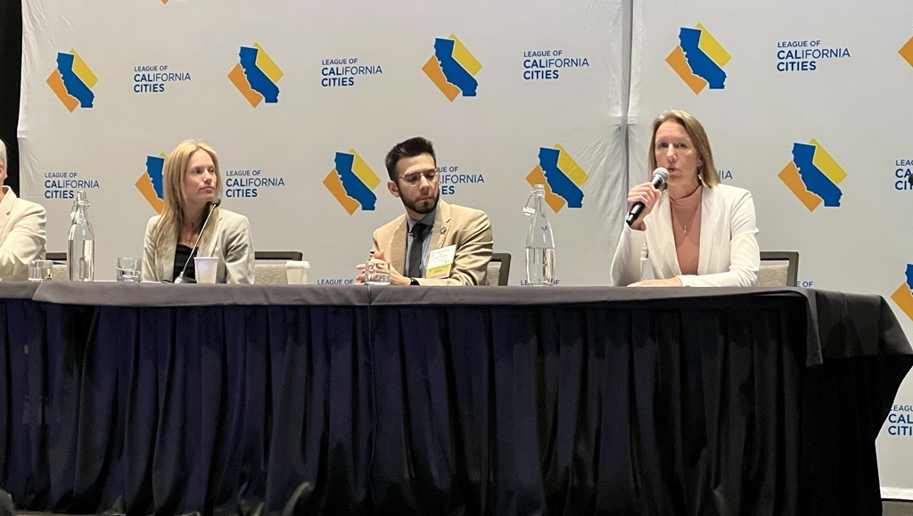
Homelessness
SB 569 (Blakespear) Department of Transportation: homeless encampments.
This measure would increase communication between the Department of Transportation and local governments to address encampments on state property.
Cal Cities Position: Co-sponsor/Support

Slide 38
Homelessness
SB 16 (Blakespear) Homeless Housing, Assistance, and Prevention program: housing element.
This measure would require all but 14 cities to provide additional information in their housing element on how their jurisdiction is responding to homelessness.
Cal Cities Position: Oppose unless amended

Slide 39
Questions?
Caroline Grinder
Legislative Advocate
cgrinder@calcities.org • 916-580-5075

Slide 40
Thank you
Jason Rhine
Senor Director, Legislative Affairs
jrhine@calcities.org

